Slide 1
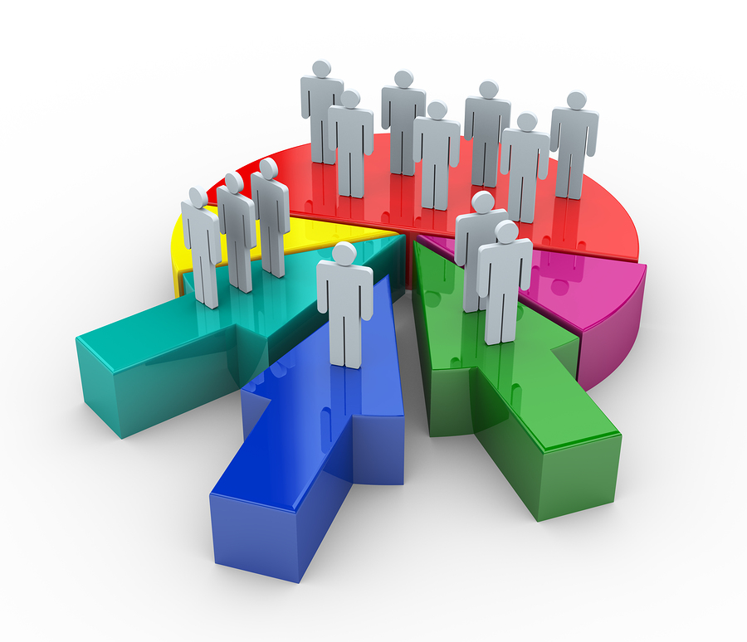
Customer Segmentation using Machine Learning Identifying Profit Enhancement Opportunities
Project 4
Contributors:
Ahmed Dahham
Uma Yeruva,
Samantha Brown
Julia Lira

Slide 2
Virtual shopping / Digital Marketing may first come to mind when you hear Machine Learning and algorithms. For this reason, we found the following project on customer segmentation in the shopping malls an interesting opportunity to see unsupervised learning in use. The goal: To identify target mall customers based on available data. Increase sales and create more efficient facilities based on .
**** Info needed to speak on Req 2 & Req 5*********

Slide 3
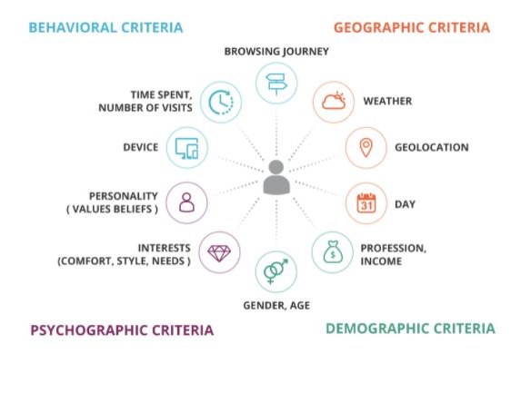
Behavioral
Geographic
Psychographic
Demographic

Slide 4
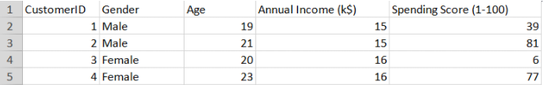
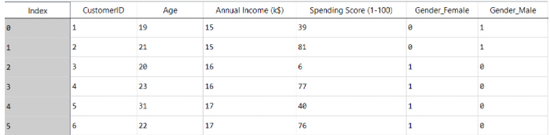
One-Hot Encoding Categorical Data Before: After:

Slide 5
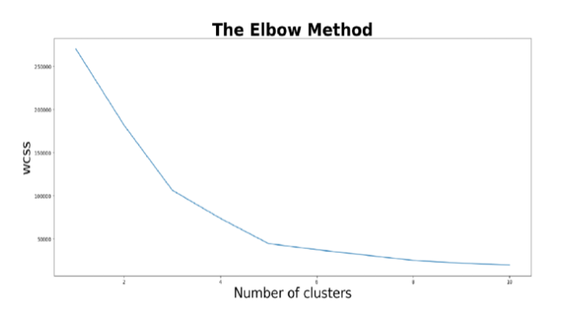
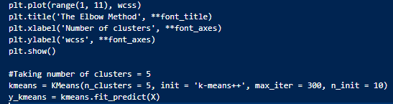
K-Means and the Elbow Method

Slide 6
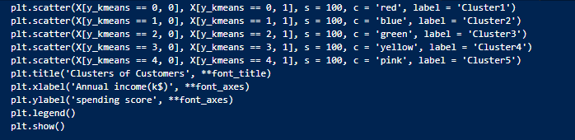
Plot the Clusters:
Cluster 1 High Income & High Spending - customer satisfaction reached
Cluster 2 Low Income & High Spending
Cluster 3 High Income & Low Spending ( area of opportunity )
Cluster 4 Low Income & Low Spending
Cluster 5 Average Income & Average Spending ( Area of opportunity )

Slide 7
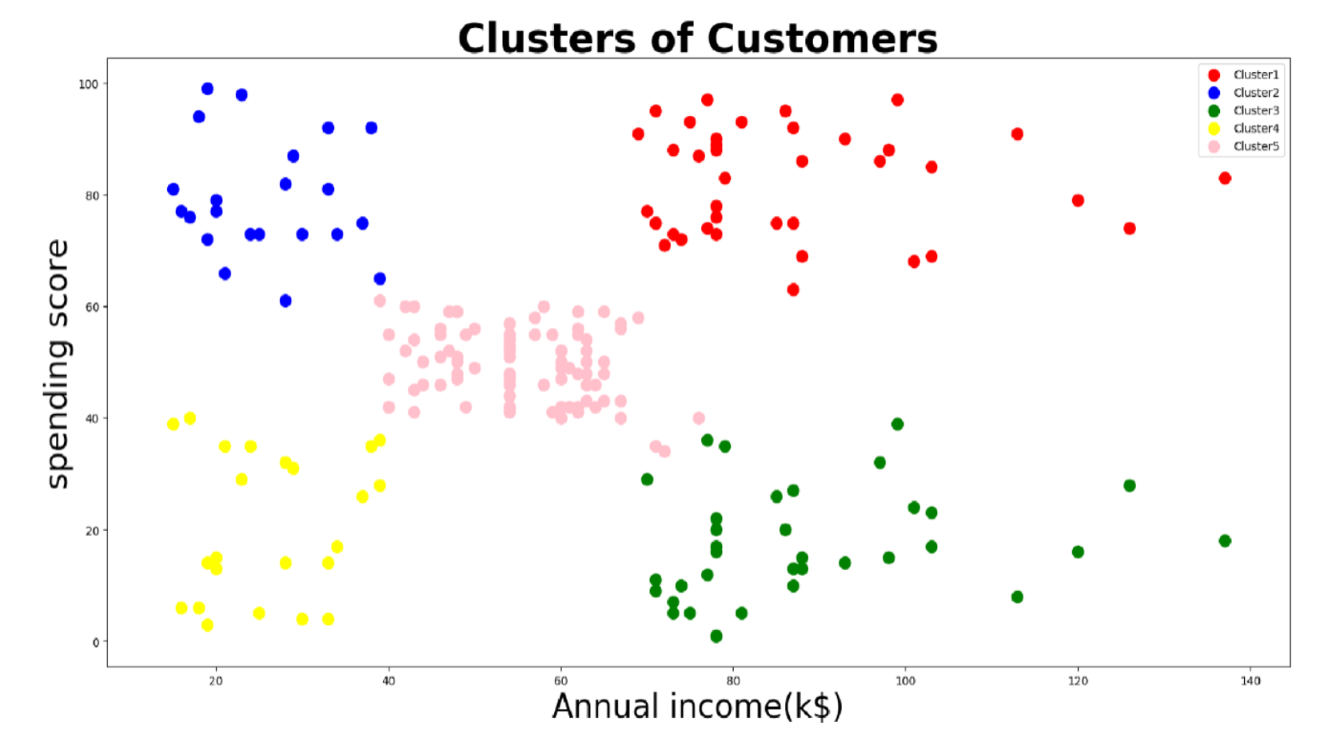
Spending Score
VS
Annual Income
The Conclusion: To optimize profits for the mall, focus should be on clusters 3 & 5.
- Cluster 3 ( High Income , low spending)
- Cluster 5 ( Average Income, average spending)

